Slide 1
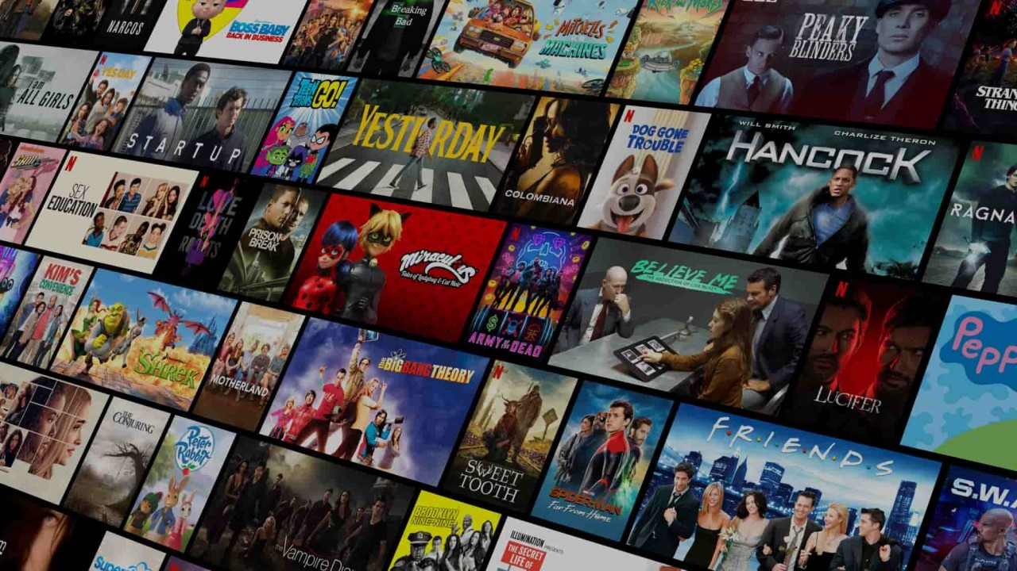





Team Tech-Connect
Akshay
Jatin
Manthan
Varada

Slide 2

INTRODUCTION
Husky-Flix Movie Application is a web application where a user can search and watch movies.
The user gets the facility of adding movies in their favorite movie list and can write their feedback and can read comments from other users.
This Photo by Unknown Author is licensed under CC BY-SA

Slide 3
Tech Stack
MERN STACK
DB : Mongo DB(Connected to MongoDB Atlas)
Front End : ReactJS, Redux, HTML, SCSS
Back End : (Rest API’s), Node(Express JS)
Token : (JWT), Bcrypt JS

Slide 4
Contributions
Akshay – REACT-YOUTUBE
Jatin - MONGODB
Manthan - STRIPE
Varada – TMDB API, IMAGE slider
ALL of us have equally contributed in implementing react components and rest api’s

Slide 5
Features
User can Sign Up and Sign In
User can take Subscription
User can add movies in Favorite list for fast access
User can write comments
User can view, like, and comment on other users’ comments
User can watch Movies (Trailers)
User can filter movies based on popularity, latest movies, rating and language
Implemented Payment Gateway using stripe
TMDB API is used to fetch the movies

Slide 6
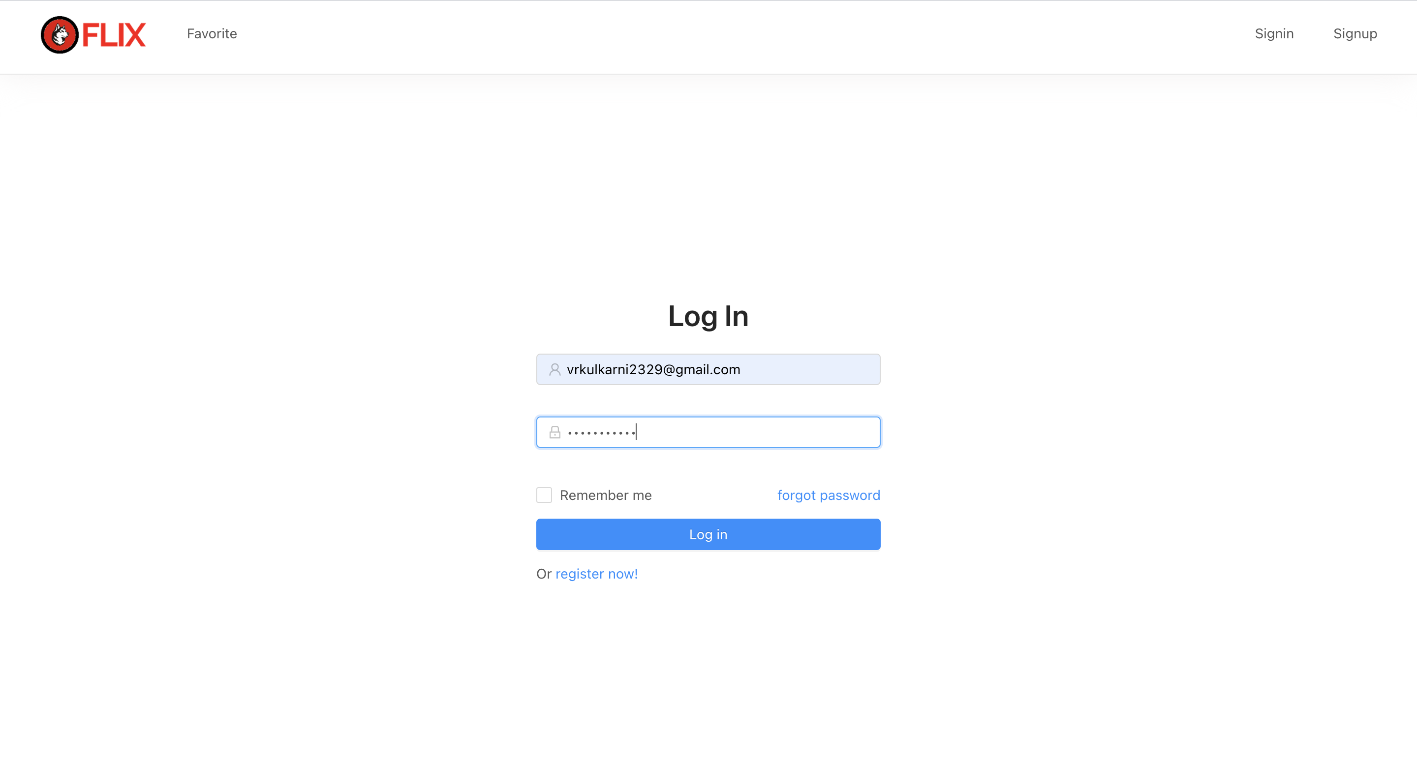
Sign In

Slide 7
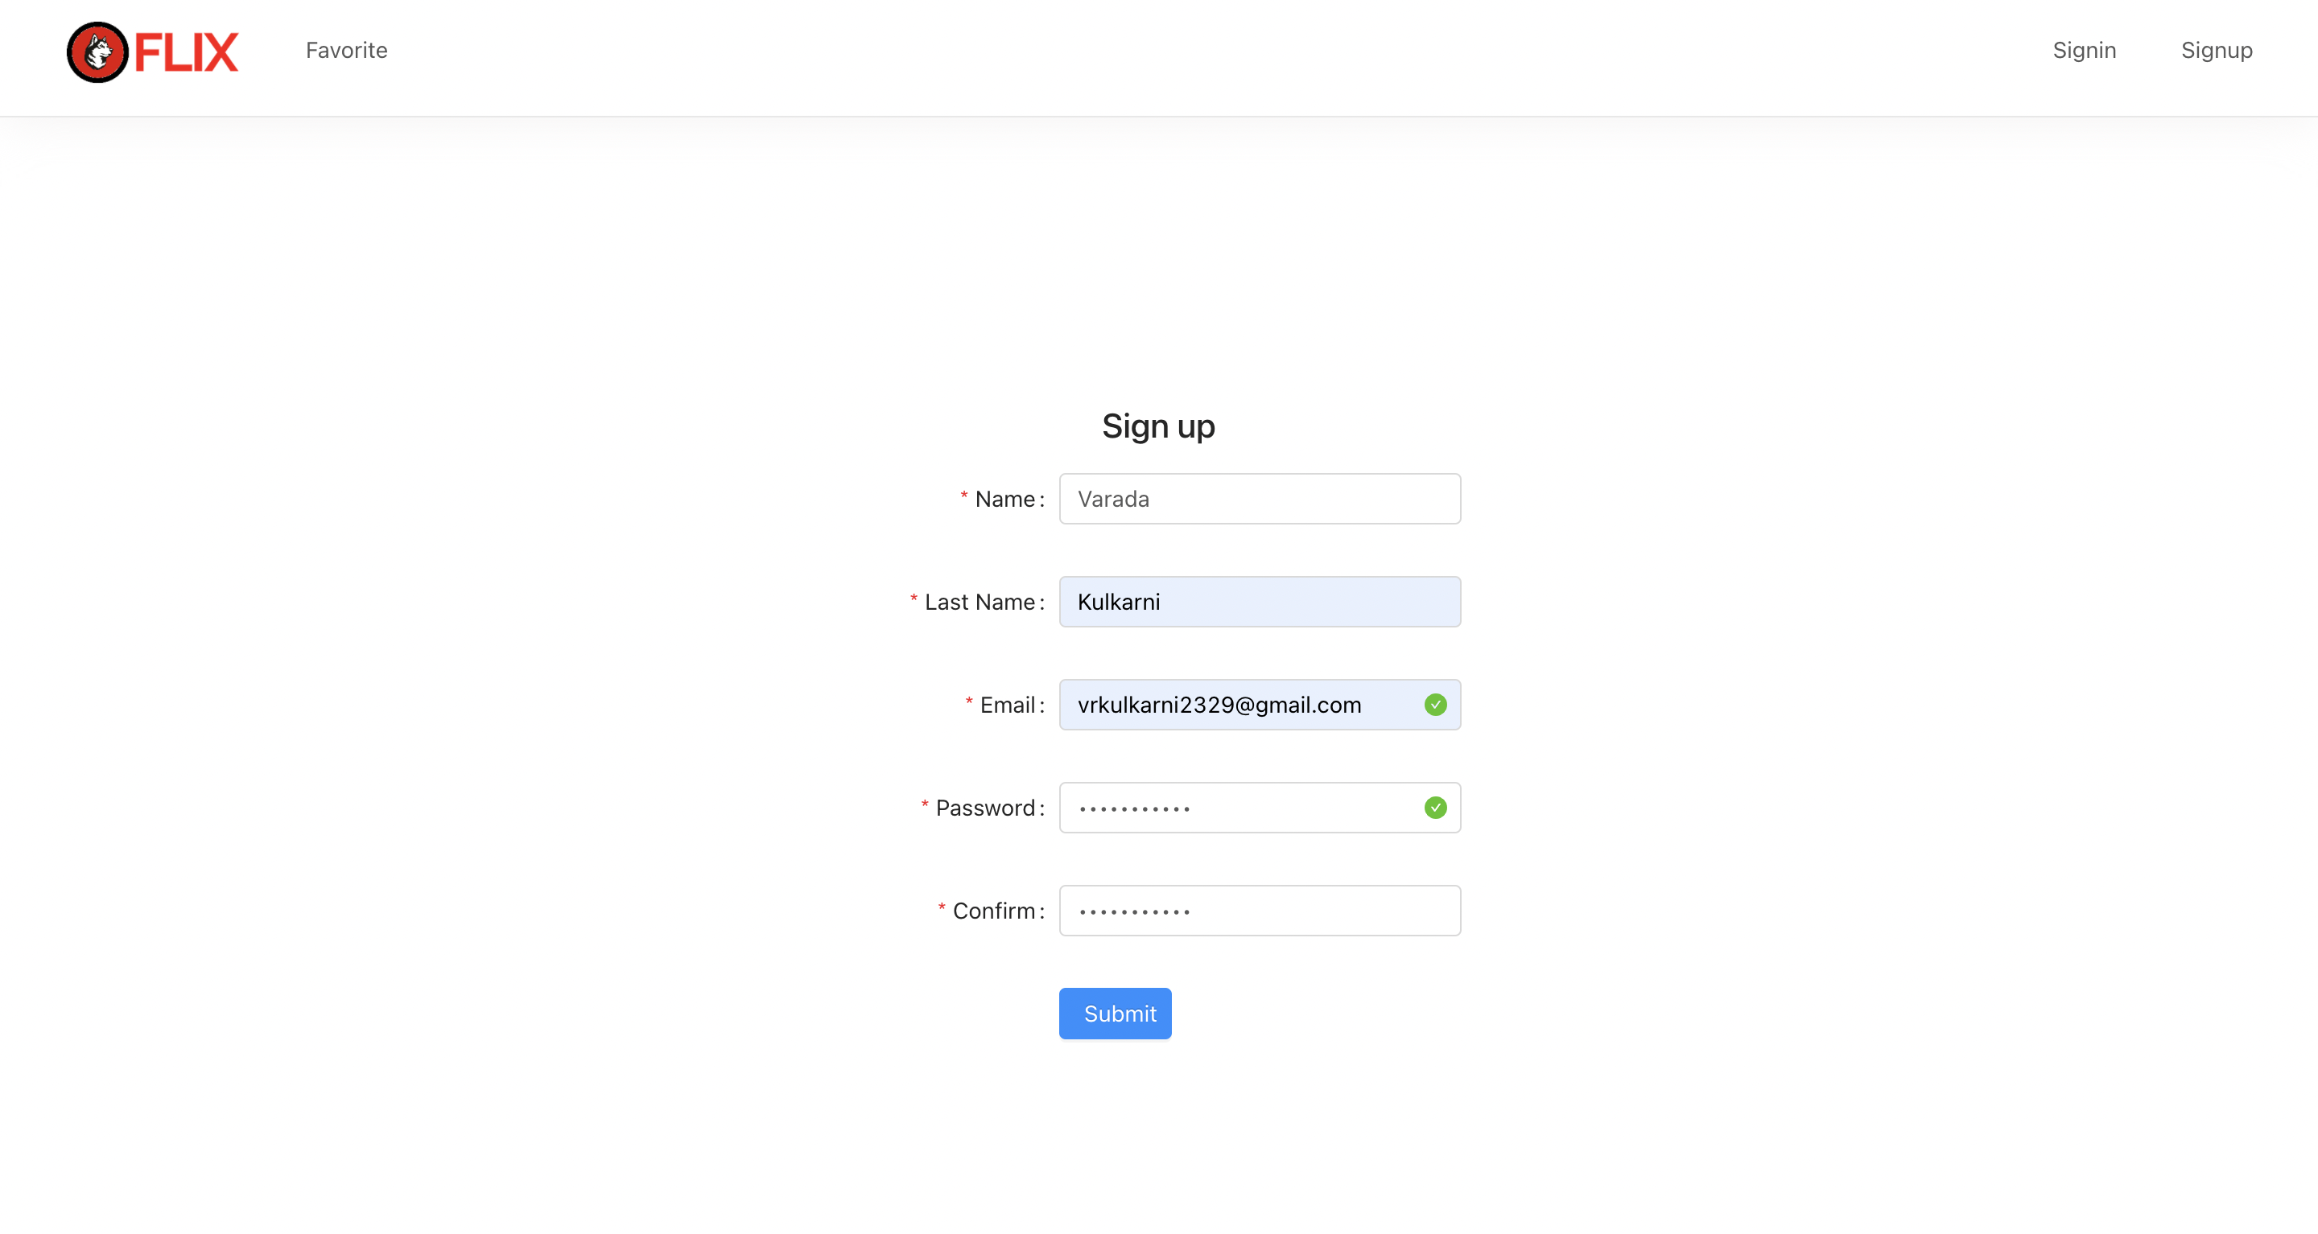
Sign Up

Slide 8
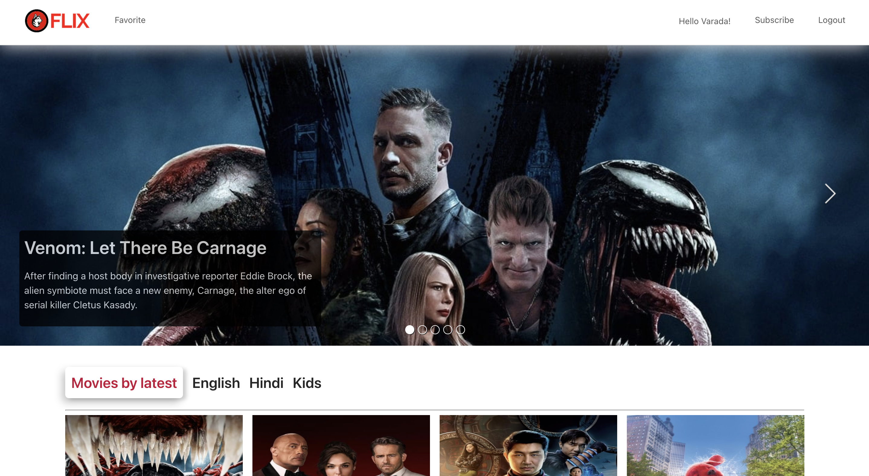
Home Page

Slide 9
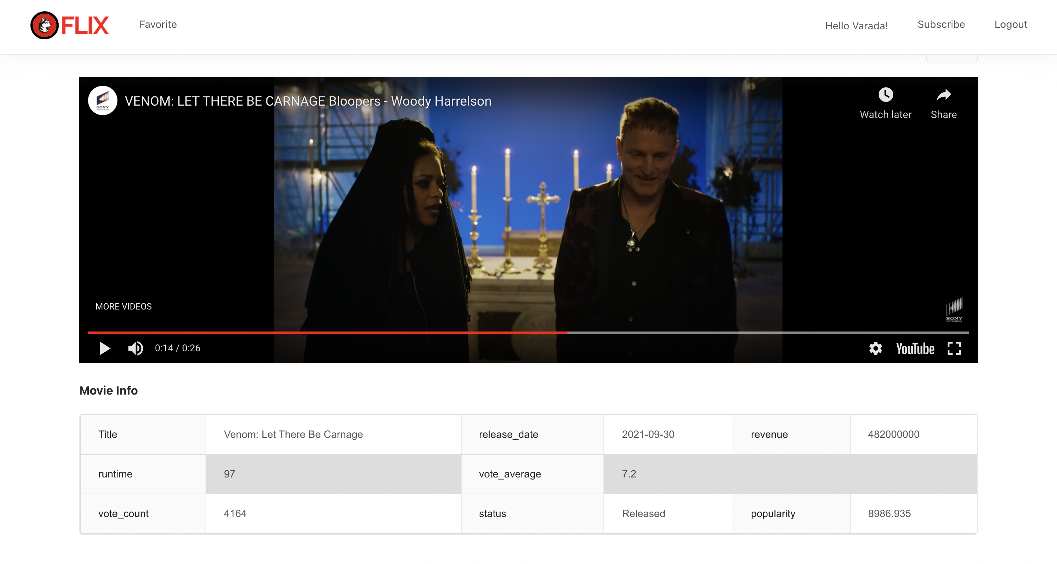
Movie Details

Slide 10
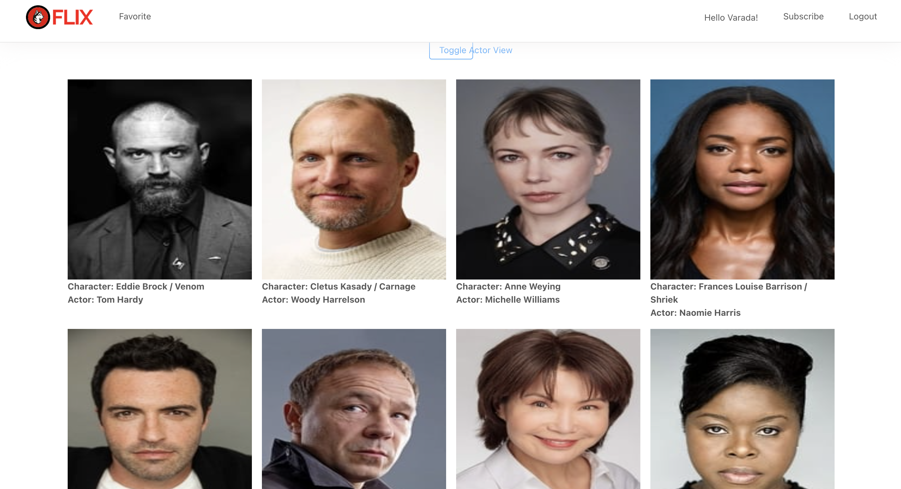
Actors

Slide 11
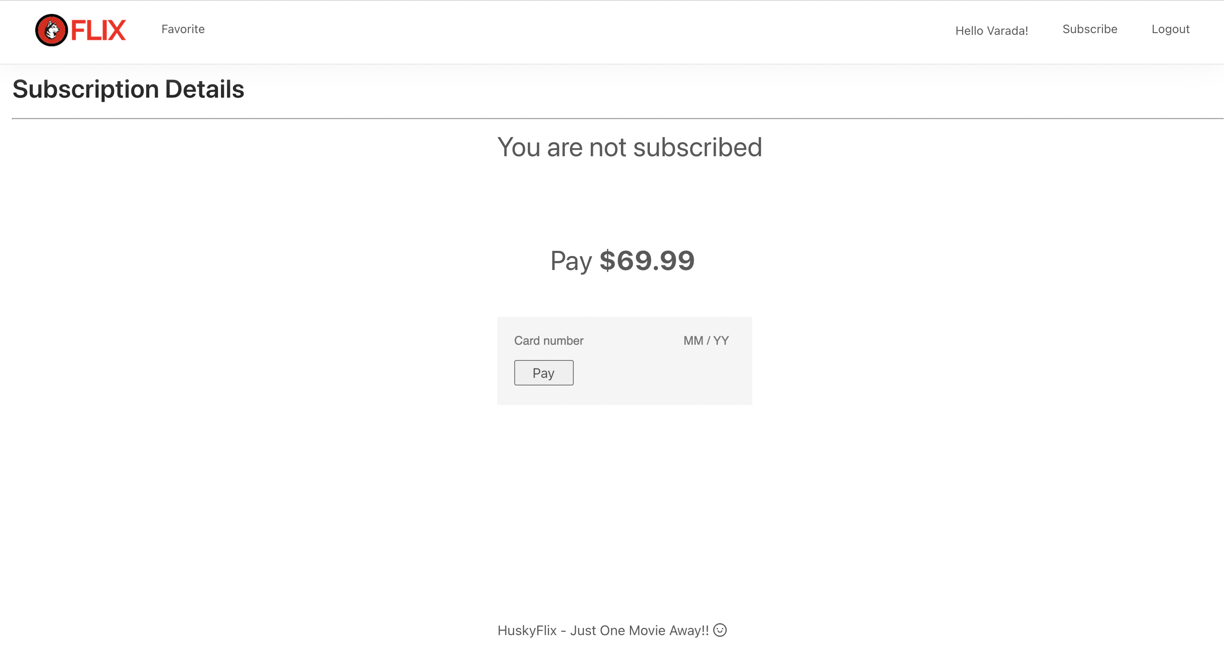
Subscription

Slide 12
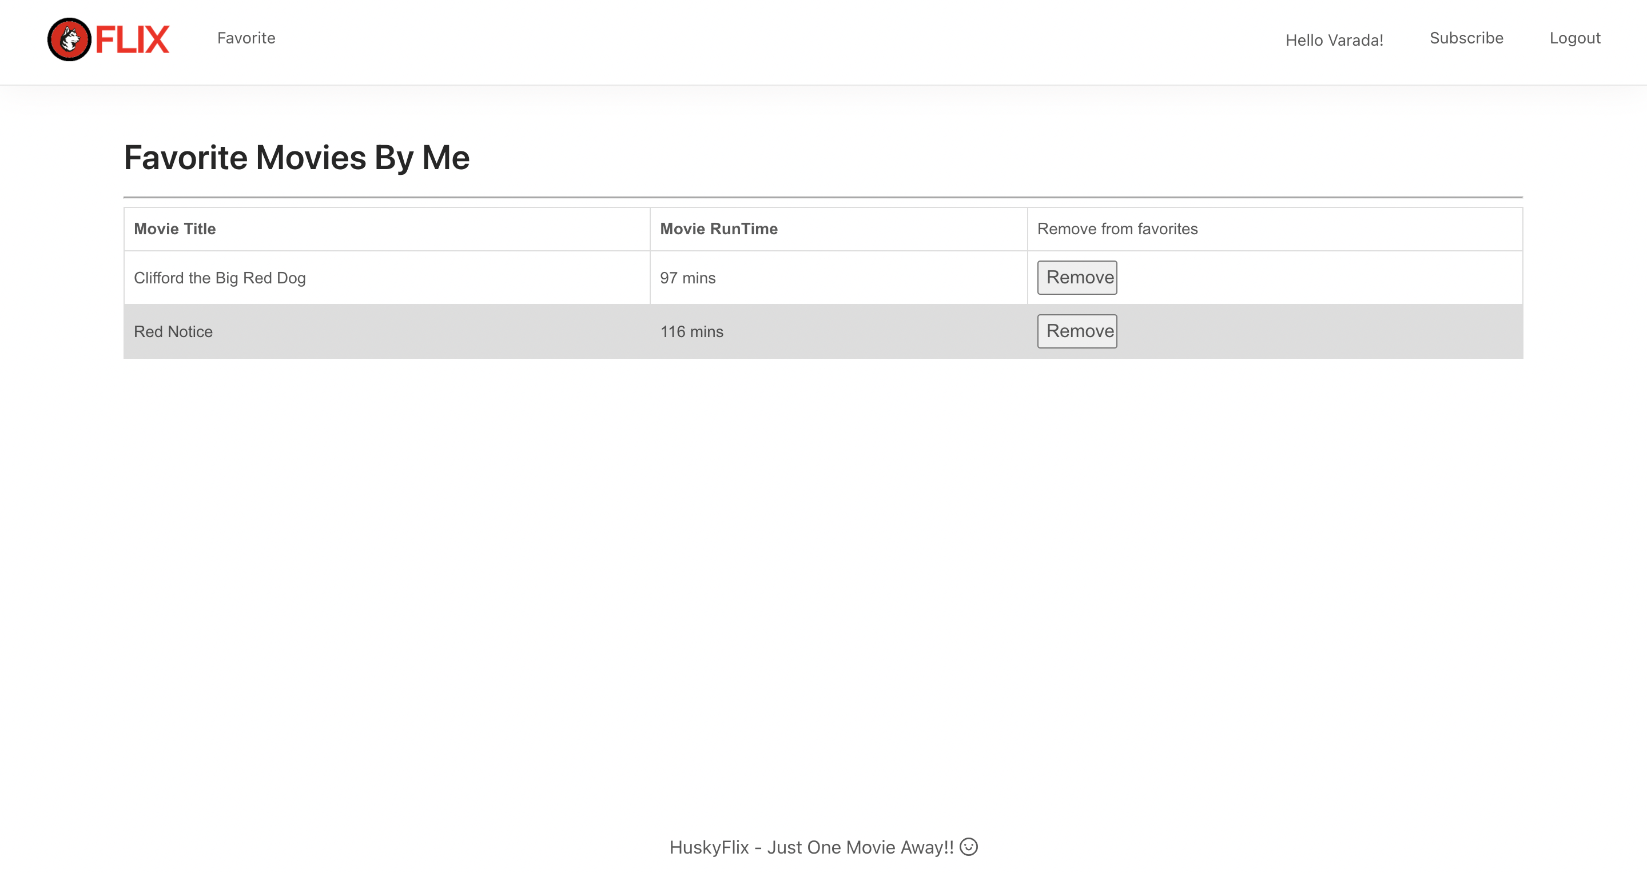
Favorite

Slide 13
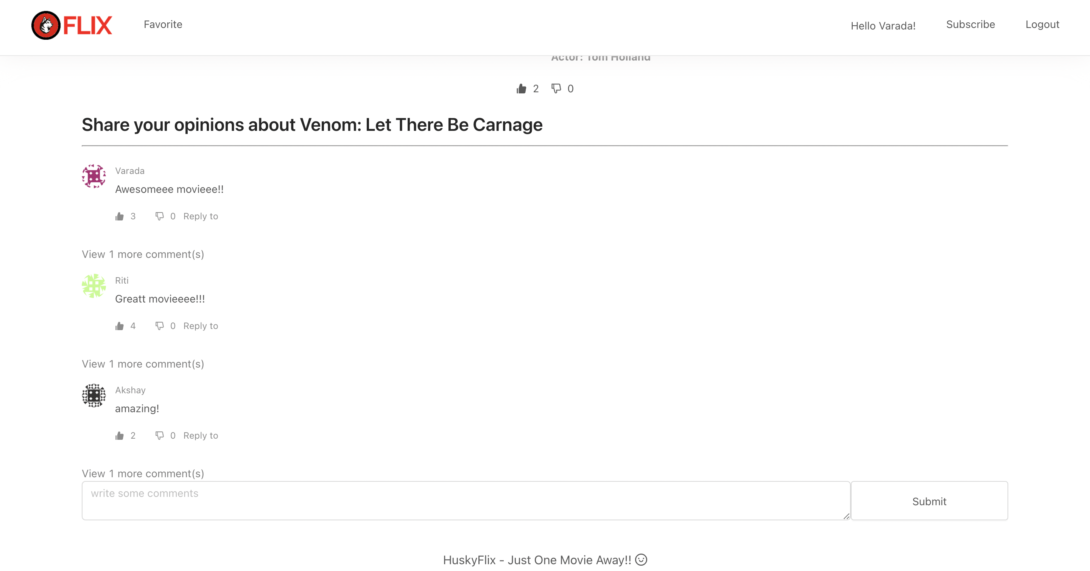
Comments & Likes Dislikes

Slide 14
References
https://reactjs.org/docs/getting-started.html
https://jwt.io/introduction
https://ant.design/docs/react/introduce
https://www.npmjs.com/package/react-youtube
https://www.npmjs.com/package/movie-trailer
https://sass-lang.com/documentation
https://stripe.com/docs/api

Slide 15
Thank you

